Slide 2
CERN OMBUD REPORT
January - December 2014
Sudeshna Datta-Cockerill
Report to TREF

Slide 3
Agenda
Role & Principles
Profiles of Visitors to Ombud’s Office
Issues
  Statistics
  Categories of Issues
Outcomes
Other Activities
  Shared practice
  Promoting a respectful workplace
Observations

Slide 4
OMBUD Role
  Provide confidential assistance in the informal resolution of interpersonal issues in the interest of the good functioning of CERN & the wellbeing of all its contributors
  Promote a respectful workplace environment through actions aimed at raising awareness & providing guidance on the day to day application of the CERN Code of Conduct
  Contribute to Organizational culture change by raising systemic issues with management, as applicable

Slide 5
OMBUD Principles
Confidentiality
Neutrality / Impartiality
Informality
Independence

Slide 6
OMBUD Statistics
January to December 2014
91 visitors to Ombud’s Office
181 issues identified = 1.9 issues / case
1 5 times / case (+ exceptionally)
Discussion – Advice - Coaching – Mediation - Intervention - Referral

Slide 7
OMBUD Statistics
35
20
12
3
8
3
1
5
4
91

Slide 8
OMBUD Statistics
28
27
55
51
40
91

Slide 9
OMBUD Categories of Issues
[Classification according to International Ombudsman Association]

Slide 10
OMBUD Categories of Issues: summary
[Classification according to International Ombudsman Association]
  Evaluative relationships*- Situations involving supervisees & supervisors
  Supervisory effectiveness – equal treatment – bullying - respect
Peer relationships
  Communication, bullying / mobbing, respect
Career progression & development
  Career development and work assignments
Values, ethics and standards
  Credit for work done – cultural habits – email exchange
Other 5 categories
  Work load – shared office space – safety
  Service and administrative issues –application of processes
  Email etiquette – LGBT posters
61%
20%
19%
*Evaluative relationships also typically most representative category in other international organizations

Slide 11
OMBUD Outcomes

Slide 12

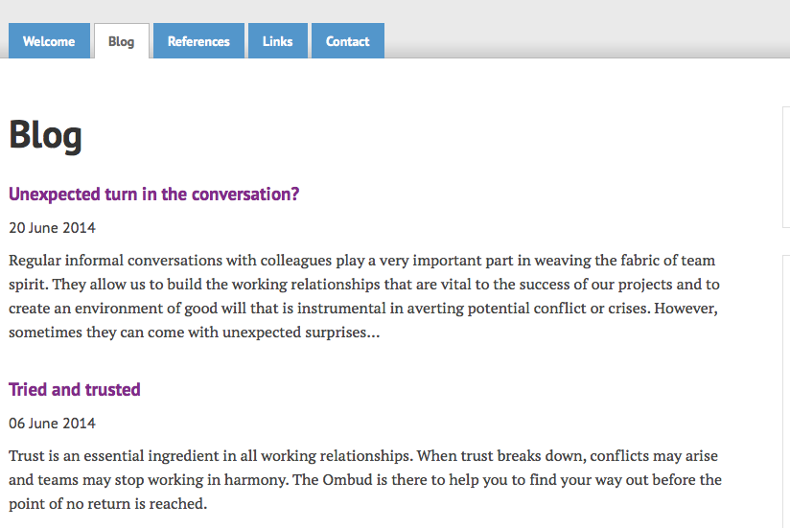
OMBUD Other Activities
…communication…
…need for more guidance & feedback…
…respect across professions / levels…
…unwelcome declarations of love…
...rumours / information flow…
… work – life balance …
…inclusiveness…
…trust…

Slide 13

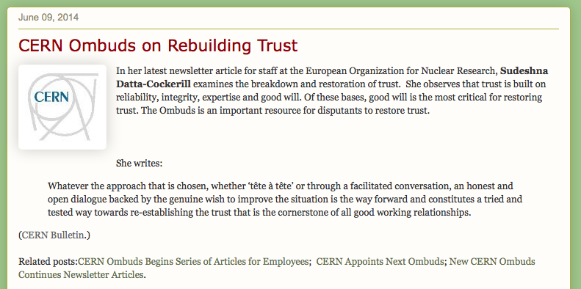
OMBUD Other Activities: shared practice
… CERN blog shared practice within
IOA
network …

Slide 14
OMBUD Other Activities: shared practice
IOA (International Ombudsman Association) annual conference
UNARIO (UN and related Organisations) annual meeting
European Ombud network annual meeting
IAF (International Association of Facilitators)
UNARIO - Geneva monthly meetings

Slide 15

OMBUD
Other Activities: respectful workplace
CERN Code of Conduct a workplace based on mutual respect
Promoting awareness through a ‘respect @ cern’ campaign
in collaboration with
Host State Relations, Diversity, Medical, Safety, Education & Communications
Bulletin articles
Respect campaign:
  Colleagues’ contributions
  Posters, door stickers, …
  Web page
  Events, e.g. speakers, …
    Linked to campaigns during year, e.g. road safety, flu campaign,
Joint logo
CERN – Geneva association

Slide 16
OMBUD Observations
Constant number of cases ~90/year [2%-3% Staff = healthy sign?]
Proportionally higher numbers of women visitors to Ombud = to be monitored
Not all visitors to Ombud familiar with CoC (particularly Users)
Majority of visitors to Ombud appear to fear disclosure or retaliation
More guidance/supervision of Fellows & Students needed
Managers used Ombud as sounding board- in anticipation
Evaluative relationships- main concern: supervisory effectiveness
Peer relationships - main concern: communication
Other - ‘Unwelcome declarations of love’ / sexist jokes
Other – lack of respect / Incivility: source of demotivation

Slide 17
OMBUD Conclusion
Smooth handover of Ombudsperson
Most cases resolved optimally – if not always to full satisfaction of parties concerned
Appreciation of safe place to talk openly
Discussions & situational coaching found useful
But…
Mediation still used rarely – fear of disclosure or retaliation
Individual willingness to address inter-personal issues
Further work & time needed to create conflict resolution culture

Slide 18
OMBUD Conclusion: Best Practice
"Ombudsman offices exist for many reasons.
Sometimes managers and employees do not know exactly why they feel concerned, but they need a safe place to go, to talk.
Sometimes a person is concerned on someone else's behalf, and needs to have options in a delicate situation.
Sometimes one sees a really good thing happening at work and would like to know how to commend it."
  Mary P. Rowe, ombudsperson, MIT, USA, pioneer in the field.

